Slide 1
Team Introductions

Slide 2
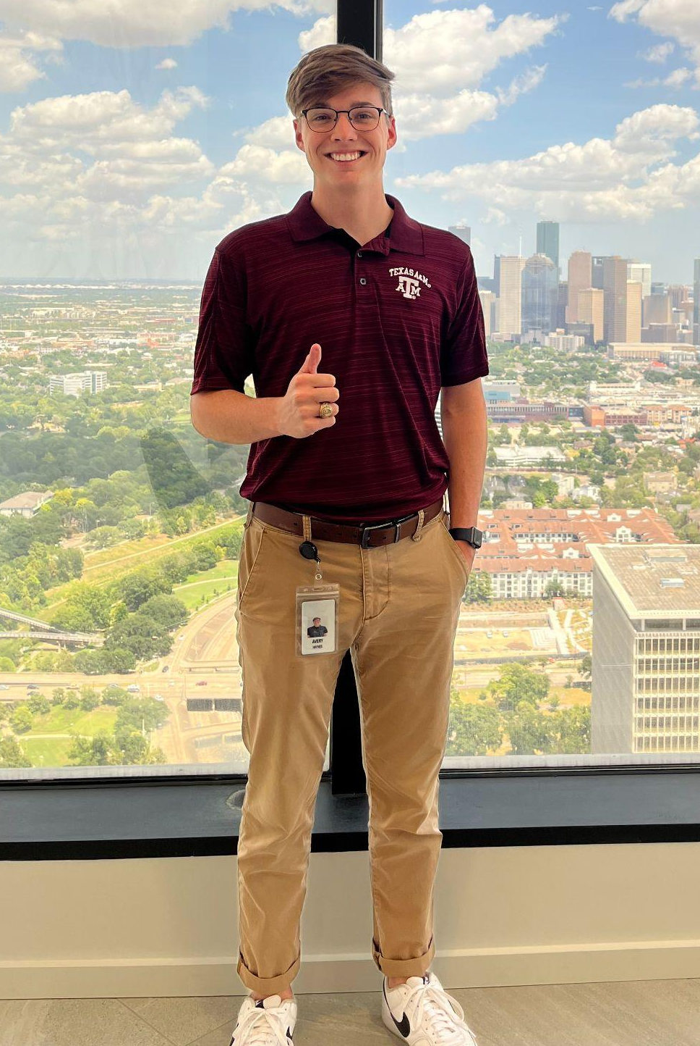
Avery Haynes
From: Cypress, TX
Education: Senior Mechanical Engineering Major, Engineering Project Management Minor
Interests: Renewable & Sustainable Energy Development, Fluid Mechanics, Heat Transfer
Experience: Shell Energy, Design and Project Management at Trillium Energy, TAMU ASME President

Slide 3
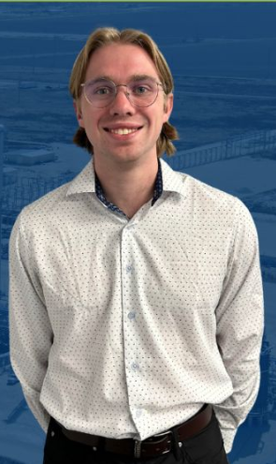
Locke Lehmann
From: Cypress, TX
Education: Senior Mechanical Engineering Major.
Interest: Renewable Energy and Engineering Design.
Experience: Solar-Fi, Engineering Design Services LLC, T.U.R.T.L.E Robotics, Medical Machinery.

Slide 4
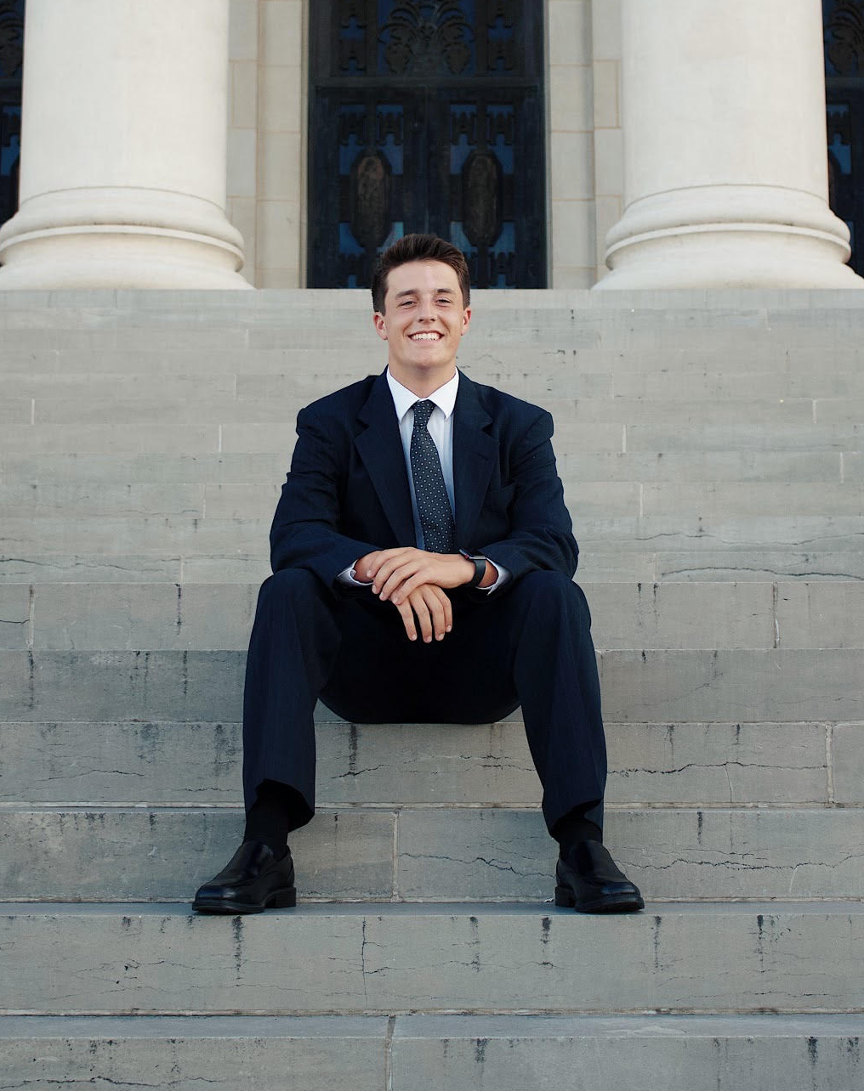
Cody Sims
From: The Woodlands TX
Education: Senior Mechanical Engineering Major
Interest: Piping system design for Oil/Gas transportation
Experience: MasTec Industrial - Industrial Construction - Pipe Field Engineer, Stick, Tig, and Mig welding

Slide 5
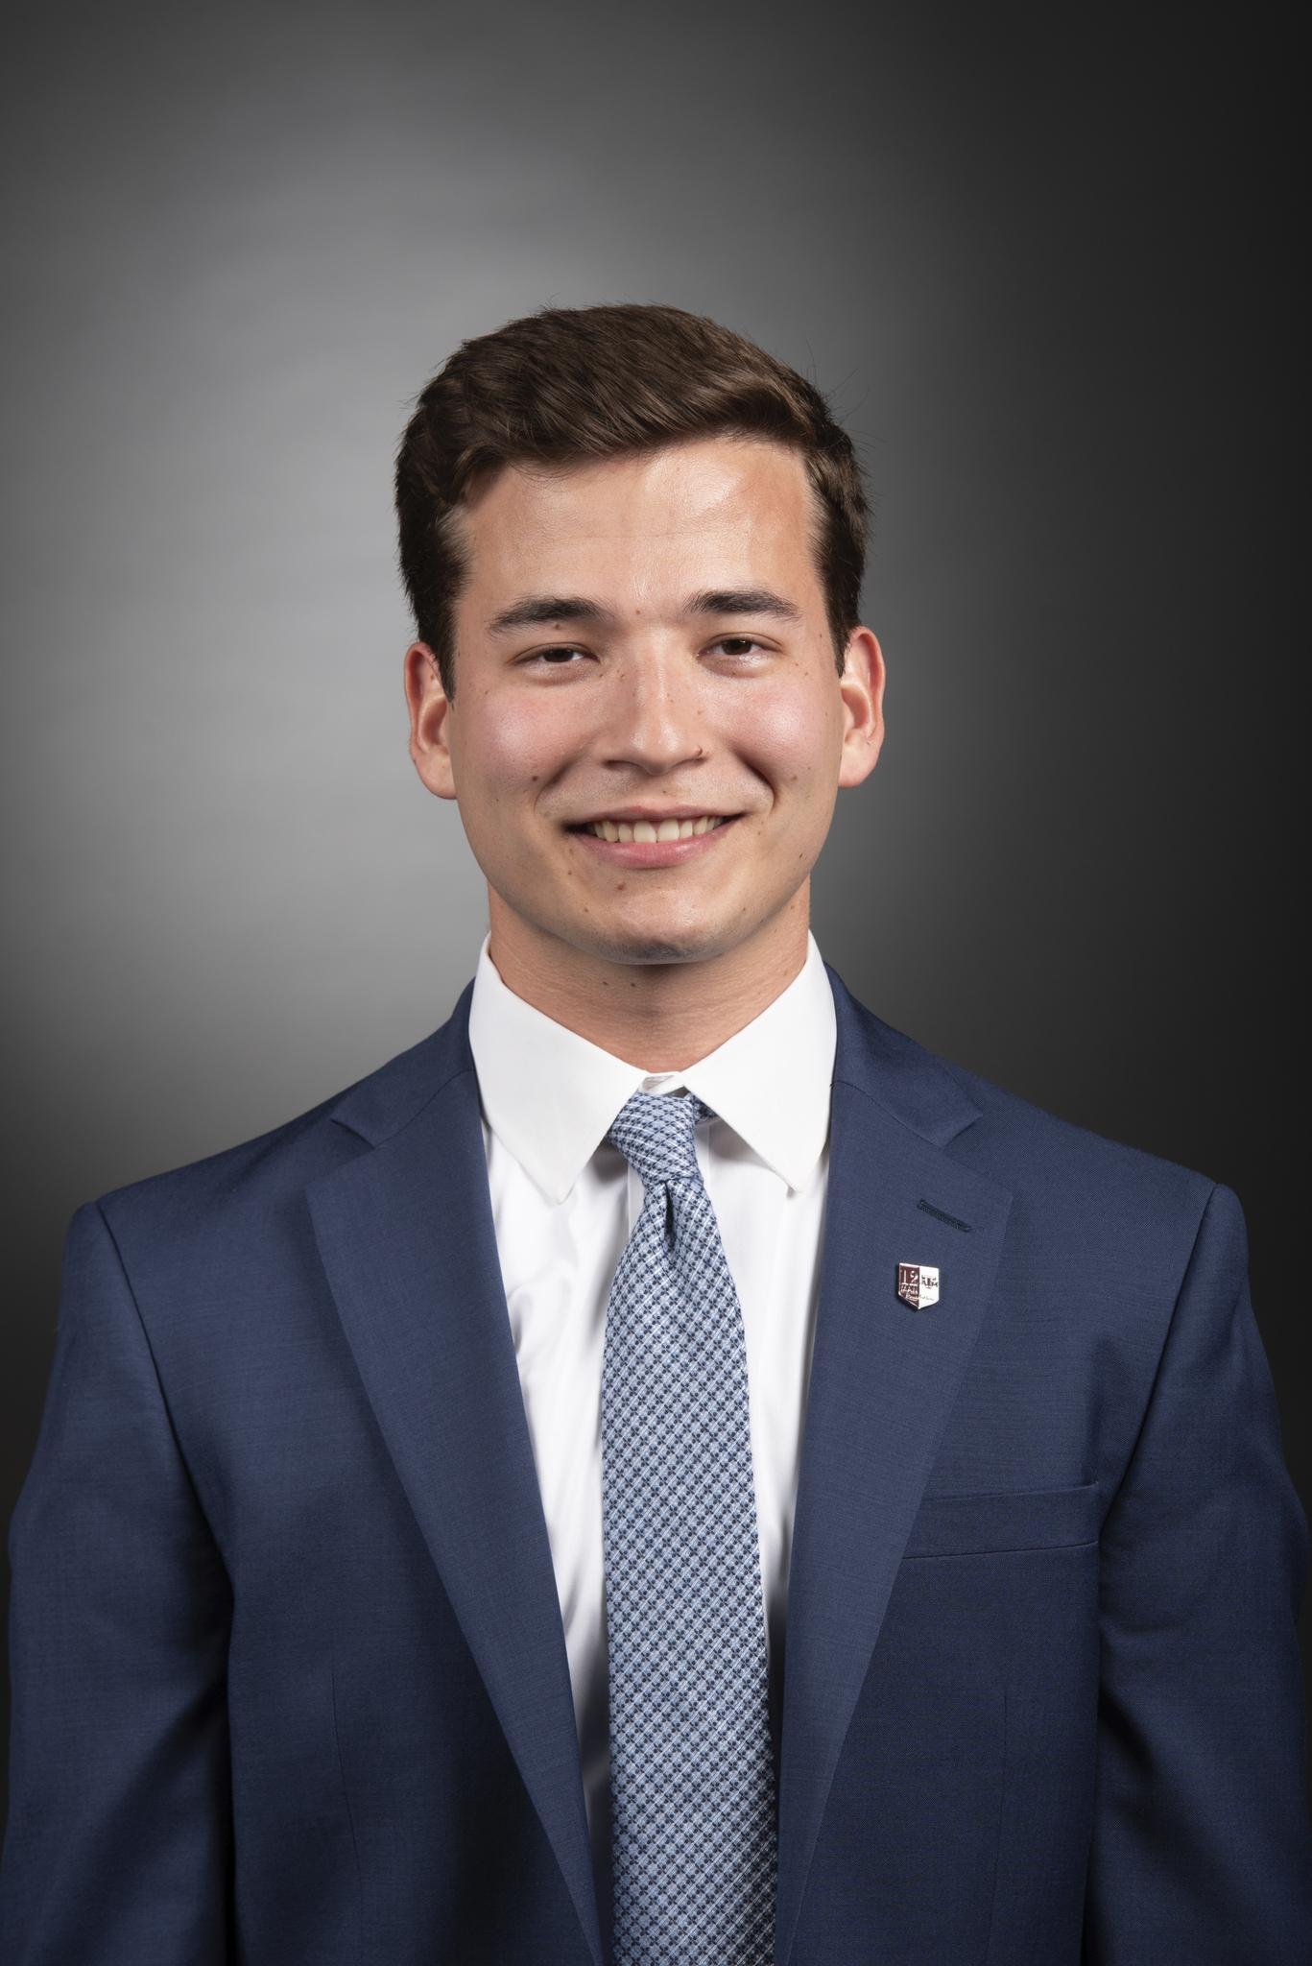
Travis Carlson
From: The Woodlands, TX
Education: Senior Mechanical Engineering Major
Expected graduation date: December 2024
Interests: Oil/Gas and Automotive Industries
Experience: Kiewit Offshore Services - Piping Engineer for ConocoPhillips Willow Project

Slide 6
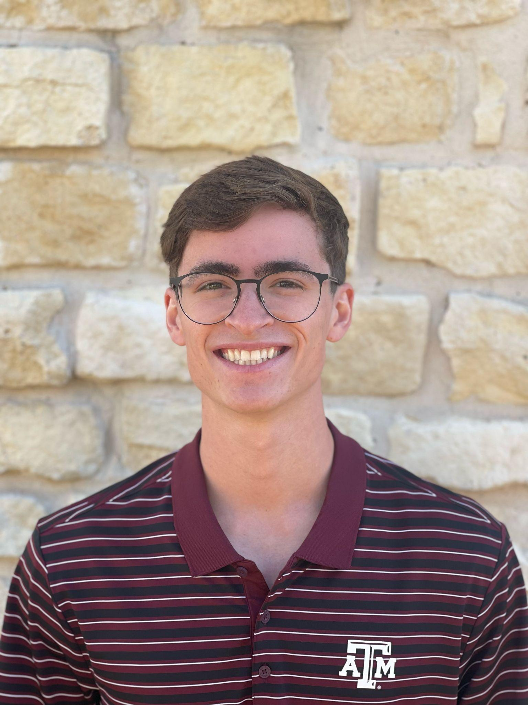
Michael Hager
From: Rowlett, TX
Education: Senior Mechanical Engineering Major, Computer Science Minor
Interest: Software Engineering
Experience: General Motors, Lone Star Circuits, Arise Wi-Fi, Texas A&M University

Slide 7
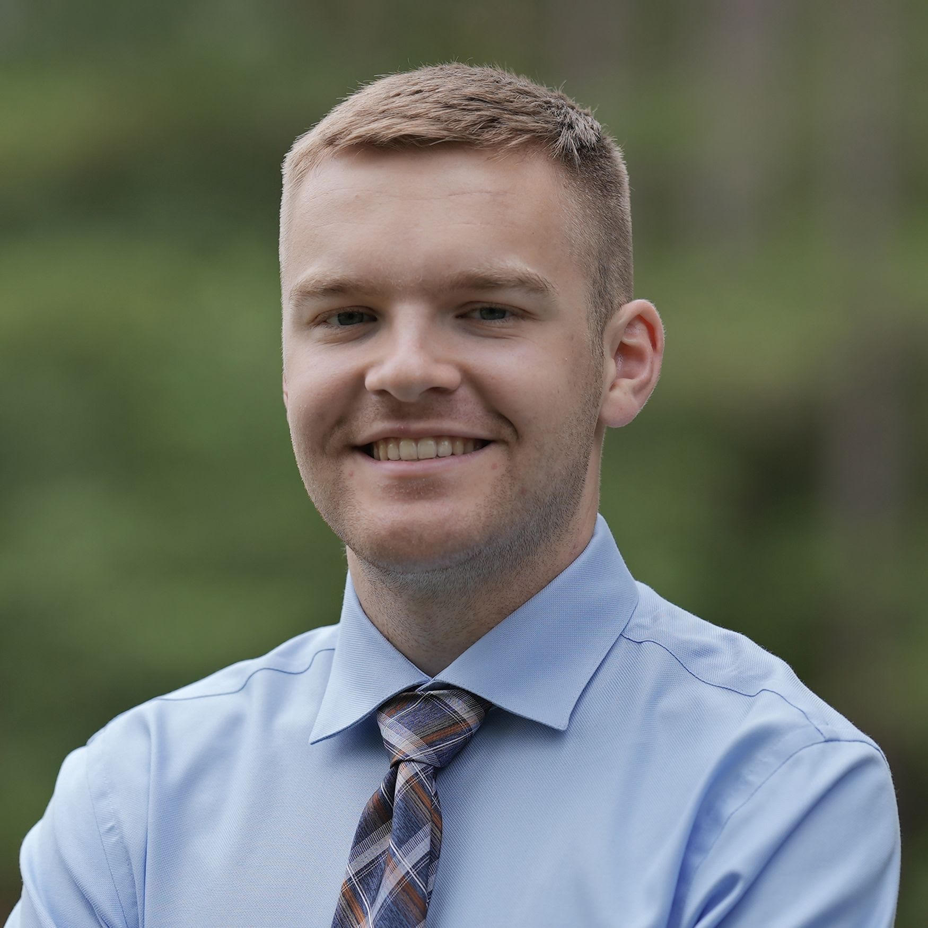
Zachary Walker
From: The Woodlands, TX
Education: Senior Mechanical Engineering major, minoring in Engineering Project Management
Interests: Automotive and manufacturing fields
Experience: Equipment Engineering internship at a semiconductor plant

